Slide 1
Histology Review & Visual Quiz
Anatomy and Physiology
Ms. Stephens
Fall 2015

Slide 2
4 Types of Tissue: Review
1. Epithelial
LOCATION: lines insides & outside of body
FUNCTION: protects, absorbs, secretes mucus
2.Connective
LOCATION: all over body, especially bones, blood, joints
FUNCTION: binds structures, supports, produce blood cells & store fat

Slide 3
3. Muscle
LOCATION:
Skeletal – attached to bones
Cardiac – in heart
Smooth – intestines, bladder, blood vessels
FUNCTION: contraction to produce movement
4. Nervous
LOCATION: brain, spinal cord, peripheral nerves
FUNCTION: coordination & control

Slide 4
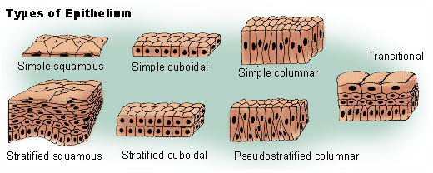
Epithelial Tissues: Review

Slide 5
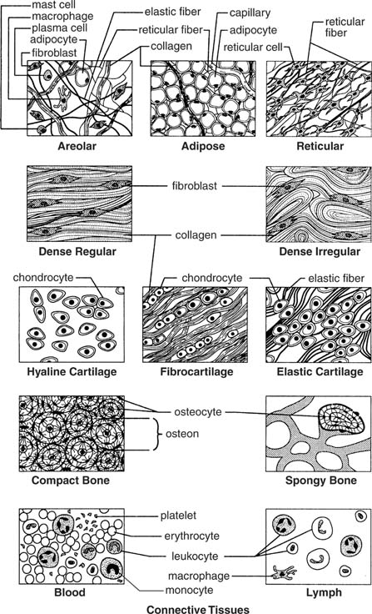
Connective Tissue: Review
1. Fibrous
Loose, dense, reticular
2. Cartilage
Hyaline, elastic, fibrocartilage
3. Bone
Compact, spongy
4. Blood

Slide 6
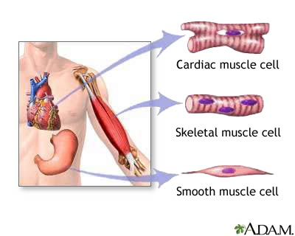
Muscular Tissue: Review

Slide 7
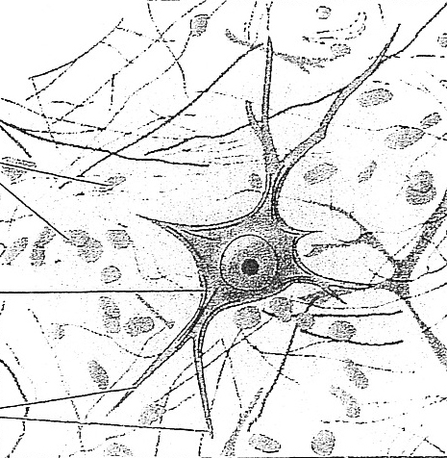
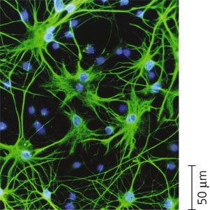
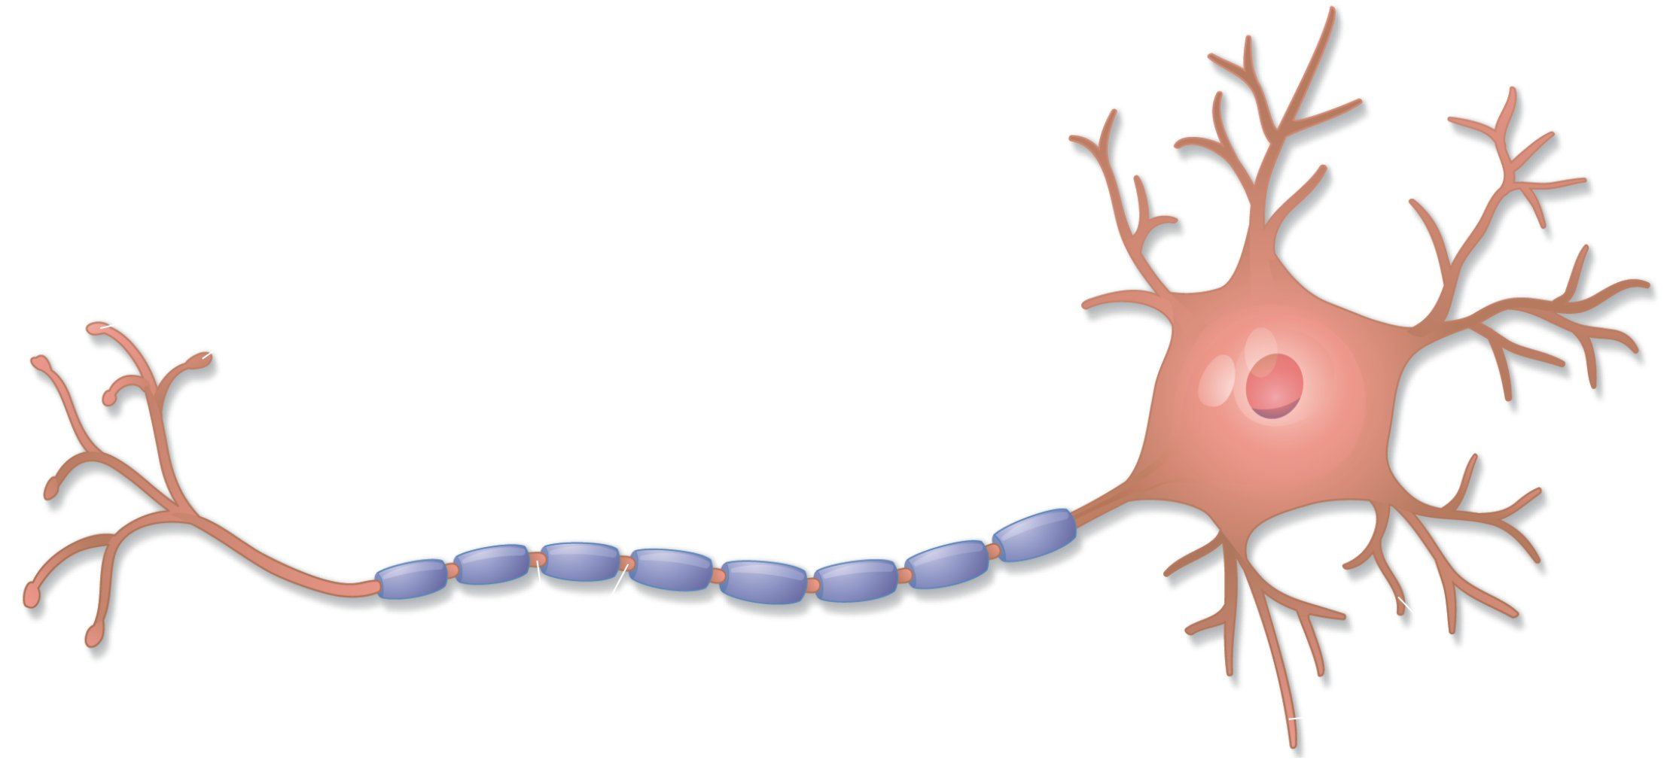
Nervous Tissue: Review

Slide 8
1. What type of tissue is this?

Slide 9
2. What type of tissue is this?

Slide 10
3. What type of tissue is this?

Slide 11
4. What type of tissue is this?

Slide 12
5. What type of tissue is this?

Slide 13
6. What type of tissue is this?

Slide 14
7. What type of tissue is this?

Slide 15
8. What type of tissue is this?

Slide 16
9. What are the cells called?

Slide 17
10. What type of tissue is this?

Slide 18
11. What type of tissue is this?

Slide 19
12. What type of tissue is this?

Slide 20
13. What type of tissue is this?

Slide 21
14. What type of tissue is this?

Slide 22
15. What type of tissue is this?

Slide 23
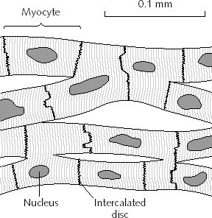
16. What type of tissue is this?

Slide 24
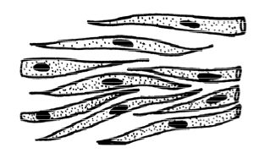
17. What type of tissue are these?

Slide 25
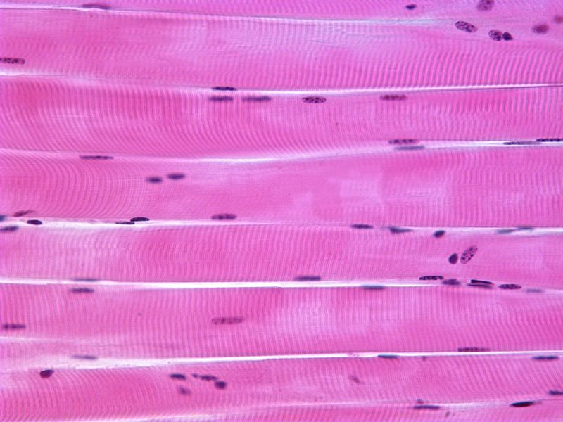
18. What type of tissue is this?
Check your answers!

