Slide 1
Chapter 1
Environmental Problems, Their Causes, and Sustainability

Slide 2
Chapter Overview Questions
What are the main themes of this book?
What keeps us alive? What is an environmentally sustainable society?
How fast is the human population growing?
What is the difference between economic growth, economic development, and environmentally sustainable economic development?

Slide 3
Chapter Overview Questions (cont’d)
What are the harmful environmental effects of poverty and affluence?
What three major human cultural changes have taken place since humans arrived?
What are the four scientific principles of sustainability and how can we use them and shared visions to build more environmentally sustainable and just societies during this century?

Slide 4
Updates Online
The latest references for topics covered in this section can be found at the book companion website. Log in to the book’s e-resources page at www.thomsonedu.com to access InfoTrac articles.
InfoTrac: Rescuing a planet under stress. Lester R. Brown. The Futurist, July-August 2006 v40 i4 p18(12).
InfoTrac: Save the planet. Tod Goldberg. Better Nutrition, April 2006 v68 i4 p56(1).
InfoTrac: Redefining American Beauty, by the Yard. Patricia Leigh Brown. The New York Times, July 13, 2006 pF1(L).
Ideal Bite
Treehugger
Earth Day Network

Slide 5
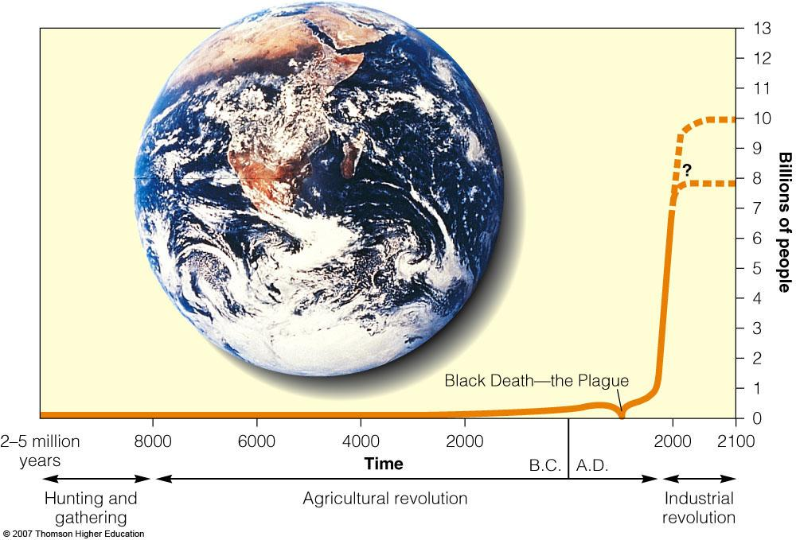
Core Case Study: Living in an Exponential Age
Human population growth: J-shaped curve
Figure 1-1

Slide 6
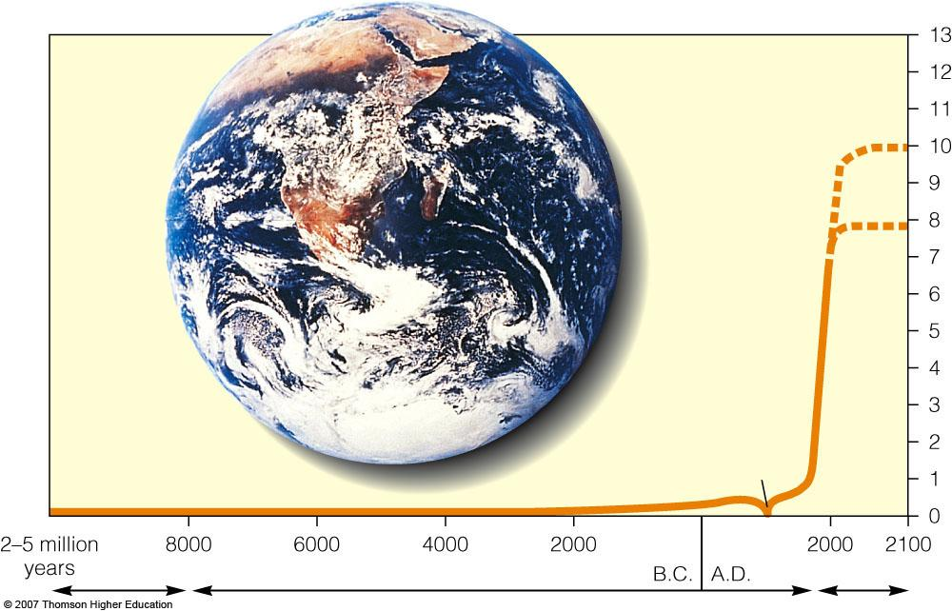
Fig. 1-1, p. 6
?
Billions of people
Black Death—the Plague
Time
Hunting and
Gathering
Industrial
Revolution
Agricultural revolution
Fig. 1-1, p. 6
Notes:
Figure 1.1
Exponential growth: the J-shaped curve of past exponential world population growth, with projections to 2100. Exponential growth starts off slowly, but as time passes the curve becomes increasingly steep. Unless death rates rise, the current world population of 6.6 billion people is projected to reach 8–10 billion people sometime this century. (This figure is not to scale.) (Data from the World Bank and United Nations; photo courtesy of NASA)

Slide 7
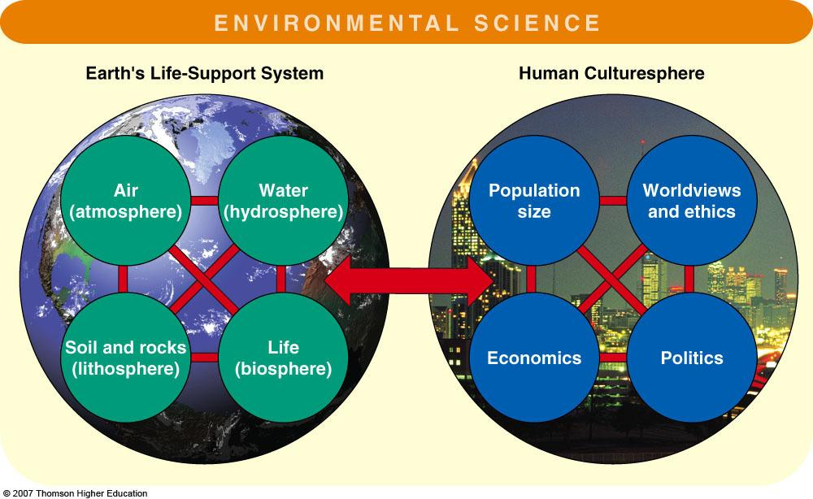
LIVING MORE SUSTAINABLY
Figure 1-2

Slide 8
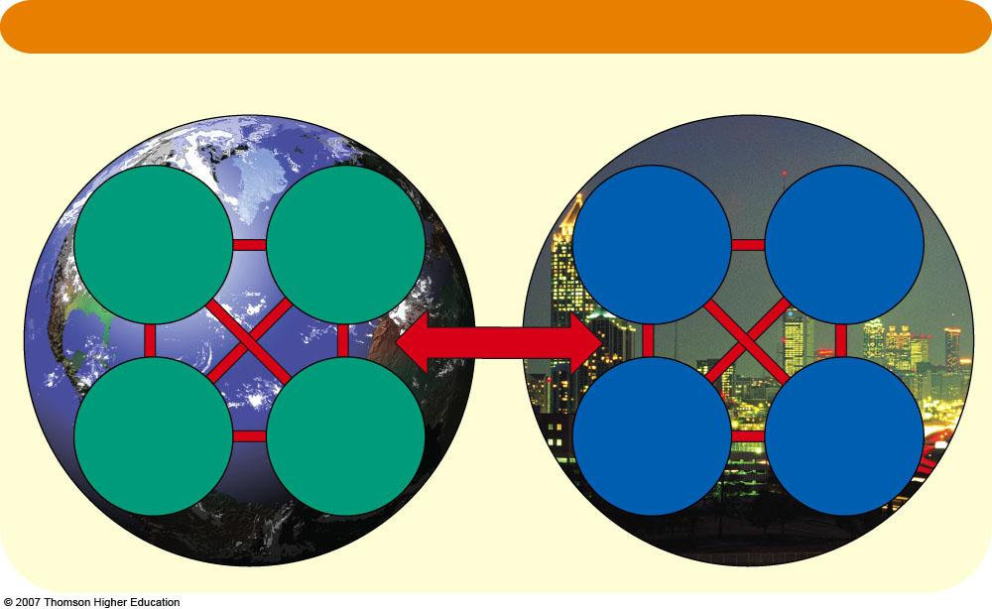
Fig. 1-2, p. 7
ENVIRONMENTAL SCIENCE
Earth's Life-Support System
Human Culturesphere
Air
(atmosphere)
Water
(hydrosphere)
Population
Size
Worldviews
and ethics
Soil and
rocks
(lithosphere)
Life
(biosphere)
Economics
Politics
Fig. 1-2, p. 7
Notes:
Figure 1.2
Environmental science is an interdisciplinary study of connections between the earth’s life-support system (left) and the human culturesphere (right).

Slide 9
What is Environmental Science?
The goals of environmental science are to learn:
how nature works.
how the environment effects us.
how we effect the environment.
how we can live more sustainably without degrading our life-support system.

Slide 10
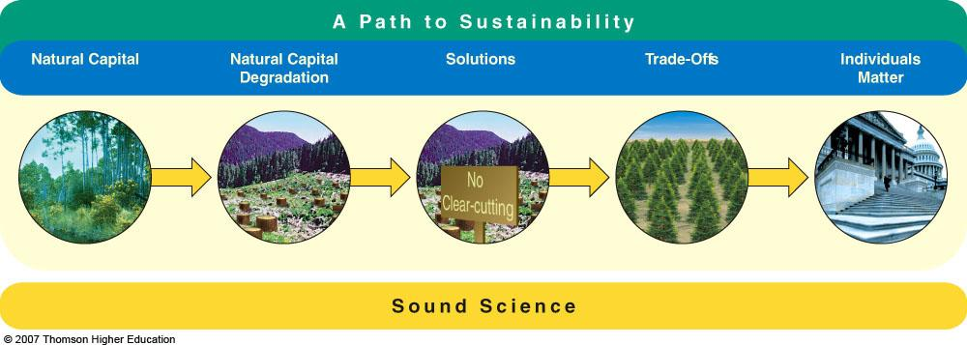
Sustainability: The Integrative Theme
Sustainability, is the ability of earth’s various systems to survive and adapt to environmental conditions indefinitely.
The steps to sustainability must be supported by sound science.
Figure 1-3

Slide 11
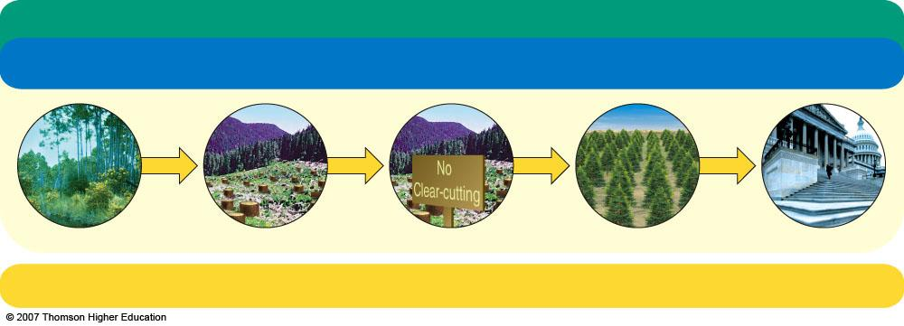
Fig. 1-3, p. 8
A Path to Sustainability
Natural Capital
Natural Capital
Degradation
Solutions
Trade-Offs
Individuals
Matter
Sound Science
Fig. 1-3, p. 8
Notes:
Figure 1.3
A path to sustainability: five subthemes are used throughout this book to illustrate how we can make the transition to more environmentally sustainable or durable societies and economies, based on sound science—concepts widely accepted by natural and social scientists in various fields.

Slide 12
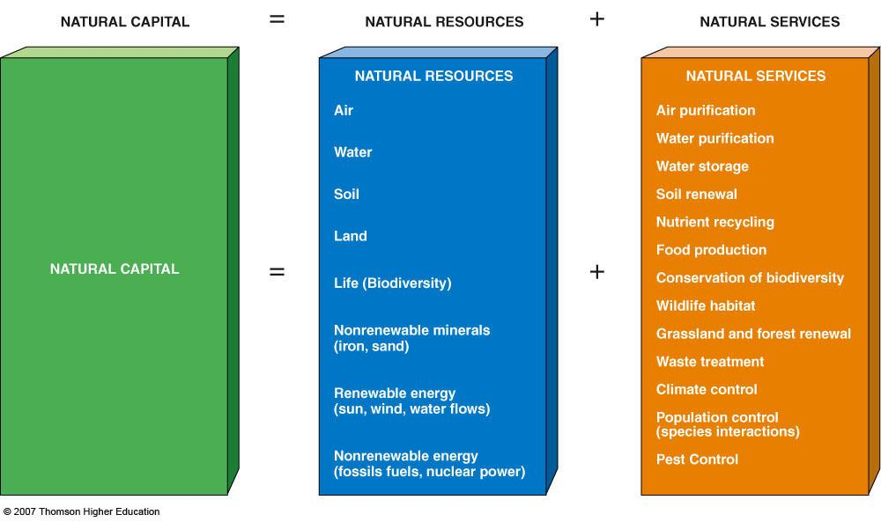
Environmentally Sustainable Societies
… meets basic needs of its people in a just and equitable manner without degrading the natural capital that supplies these resources.
Figure 1-4

Slide 13
NATURAL RESOURCE SERVICES
NATURAL CAPITAL
=
NATURAL RESOURCES
+
NATURAL SERVICES
NATURAL RESOURCES
NATURAL SERVICES
NATURAL RESOURCES
NATURAL SERVICES
Air
Air purification
Water purification
Water
Water storage
Soil
Soil renewal
Nutrient recycling
Land
Food production
NATURAL CAPITAL
=
Life (Biodiversity)
+
Conservation of biodiversity
Nonrenewable minerals
(iron, sand)
Wildlife habitat
Grassland and forest renewal
Renewable energy
sun, wind, water flows
Waste treatment
Climate control
Population control
(species interactions
Nonrenewable energy (fossil fuels, nuclear power)
Pest Control
Fig. 1-4, p. 9
Notes:
Figure 1.4
Natural capital: the natural resources (center) and natural services (right) that support and sustain the earth’s life and economies. For example, nutrients or chemicals such as carbon and nitrogen, which plants and animals need as resources, are recycled through the air, water, soil, and organisms by the natural process of nutrient cycling. And the interactions and competition of different types of plants and animals (species) for resources (nutrients) keep any single species from taking over through the natural service of population control. Colored wedges are shown at the beginning of most chapters in this book to show the natural resources (blue wedges) and natural services (orange wedges) discussed in these chapters.

Slide 14
NATURAL CAPITAL
=
NATURAL RESOURCES
+
NATURAL SERVICES
NATURAL RESOURCES
NATURAL CAPITAL
Air
Water
Soil
Land
Life (biodiversity)
Nonrenewable minerals (iron, sand)
Renewable energy
(sun, wind, water flows)
Nonrenewable energy (fossil fuels, nuclear power)
Air purification
Water purification
Soil renewal
Nutrient recycling
Food production
Pollination
Grassland renewal
Forest renewal
Waste treatment
Climate Control
Population control (species interactions)
Pest control
NATURAL CAPITAL
=
+
Stepped Art
Fig. 1-4, p. 9

Slide 15
POPULATION GROWTH, ECONOMIC GROWTH, AND ECONOMIC DEVELOPMENT
Economic growth provides people with more goods and services.
Measured in gross domestic product (GDP) and purchasing power parity (PPP).
Economic development uses economic growth to improve living standards.
The world’s countries economic status (developed vs. developing) are based on their degree of industrialization and GDP-PPP.

Slide 16
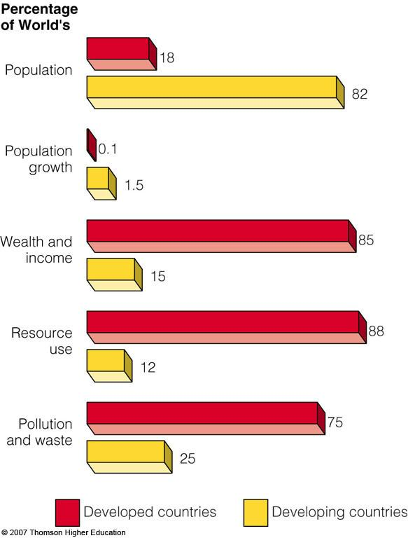
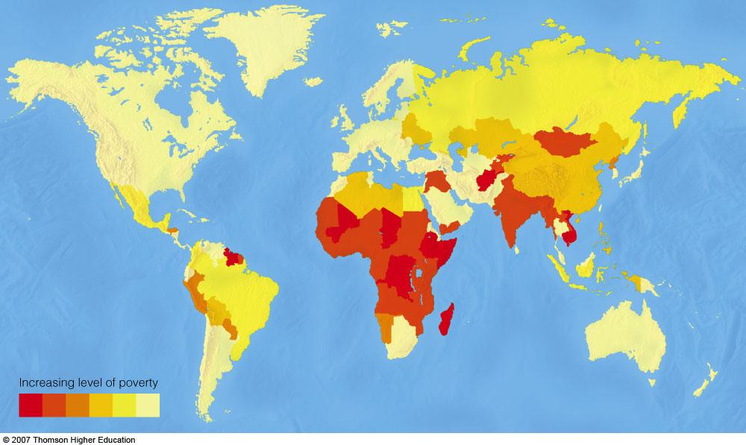
Global Outlook
Comparison of developed and developing countries.
Figures 1-5 and 1-6

Slide 17
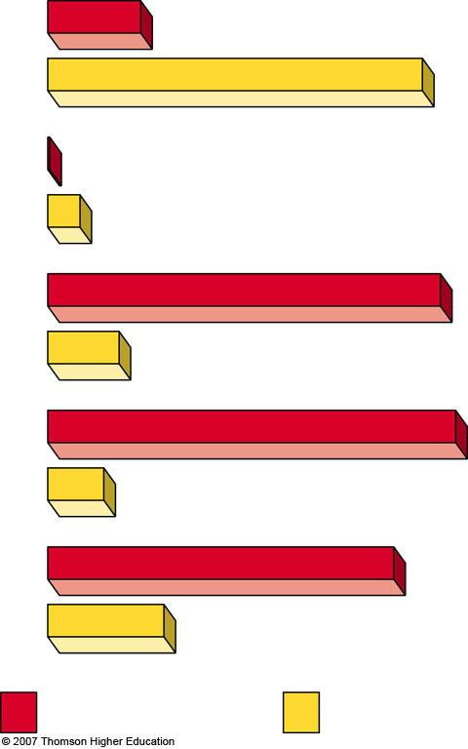
Fig. 1-5, p. 11
Percentage of World's
18
Population
82
Population
Growth
0.1
1.5
Wealth and
Income
85
15
Resource
use
88
12
Pollution
and waste
75
25
Developed countries
Developing countries
Fig. 1-5, p. 11
Notes:
Figure 1.5
Global outlook: comparison of developed and developing countries, 2006. (Data from the United Nations and the World Bank)

Slide 18
Fig. 1-6, p. 11
Fig. 1-6, p. 11
Notes:
Figure 1.6
Generalized distribution of poverty. Poverty is found mostly in the southern hemisphere, largely because of unfavorable climates and geological bad luck in terms of fertile soils, minerals, and fossil fuel supplies. (Data from United Nations and World Bank)

Slide 19
RESOURCES
Perpetual: On a human time scale are continuous.
Renewable: On a human time scale can be replenished rapidly (e.g. hours to several decades).
Nonrenewable: On a human time scale are in fixed supply.

Slide 20
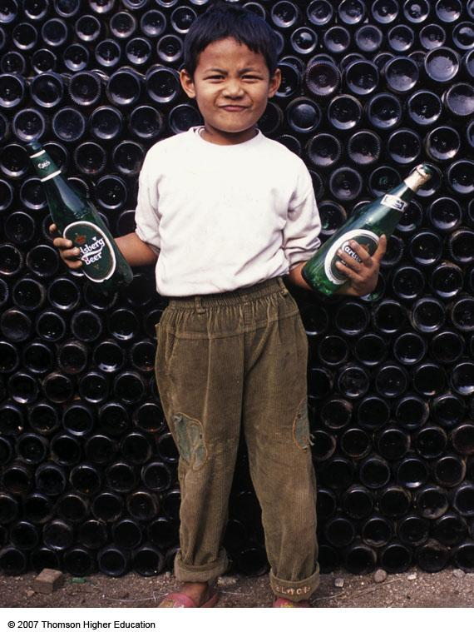
Nonrenewable Resources
Figure 1-8

Slide 21
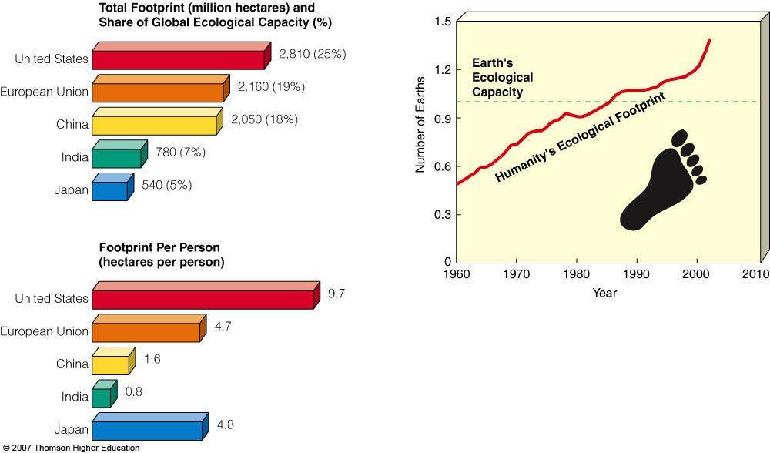
Our Ecological Footprint
Humanity’s ecological footprint has exceeded earths ecological capacity.
Figure 1-7

Slide 22
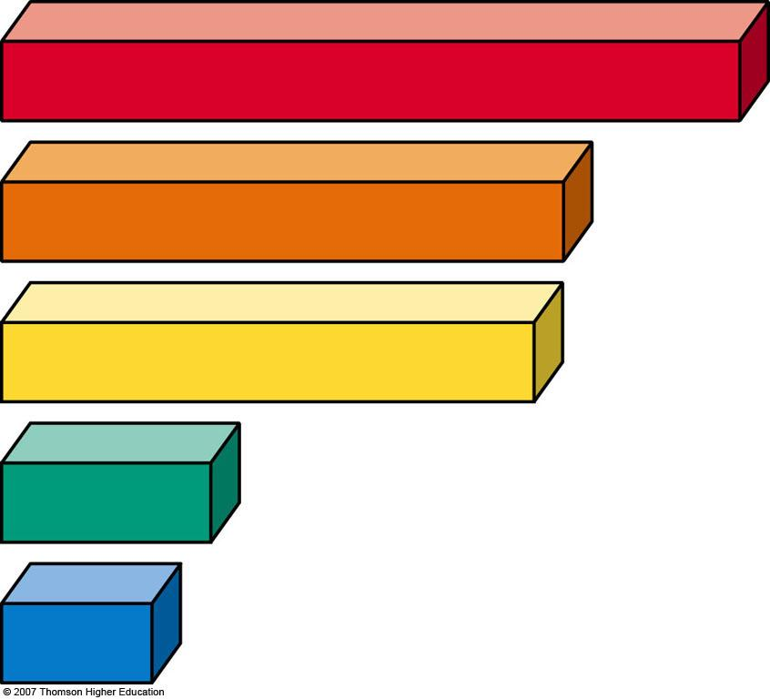
Fig. 1-7a, p. 13
Total Footprint (million hectares) and
Share of Global Ecological Capacity (%)
2,810 (25%)
United States
2,160 (19%)
European Union
2,050 (18%)
China
India
780 (7%)
Japan
540 (5%)
Fig. 1-7a, p. 13
Notes:
Figure 1.7
Natural capital use and degradation: total and per capita ecological footprints of selected countries in 2002 (left). By 2002, humanity’s average ecological footprint was about 39% higher than the earth’s ecological capacity (right). (Data from Worldwide Fund for Nature, UN Environment Programme, Global Footprint Network, Worldwatch Institute)

Slide 23
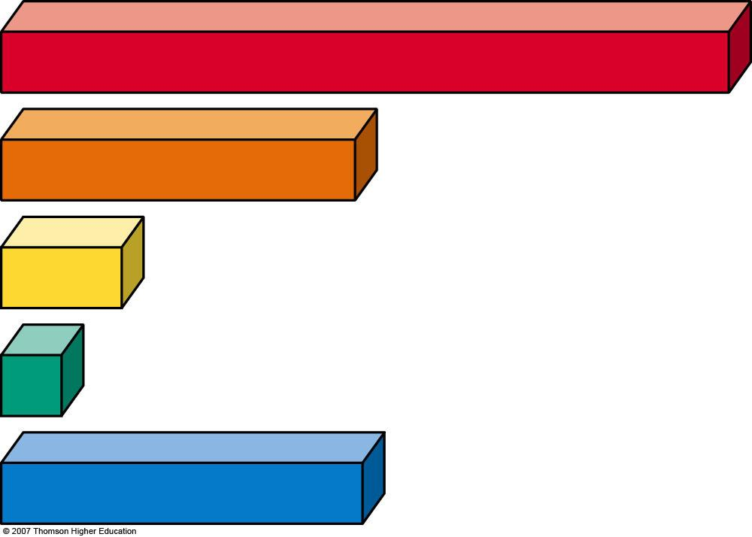
Fig. 1-7b, p. 13
Footprint Per Person
(hectares per person)
United States
9.7
4.7
European Union
1.6
China
0.8
India
4.8
Japan
Fig. 1-7b, p. 13
Notes:
Figure 1.7
Natural capital use and degradation: total and per capita ecological footprints of selected countries in 2002 (left). By 2002, humanity’s average ecological footprint was about 39% higher than the earth’s ecological capacity (right). (Data from Worldwide Fund for Nature, UN Environment Programme, Global Footprint Network, Worldwatch Institute)

Slide 24
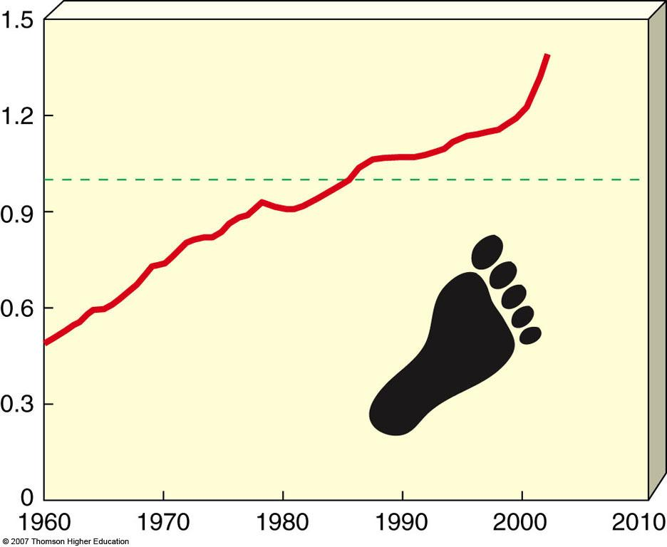
Fig. 1-7c, p. 13
Earth’s Ecological Capacity
Number of Earths
Humanity's Ecological Footprint
Year
Fig. 1-7c, p. 13
Notes:
Figure 1.7
Natural capital use and degradation: total and per capita ecological footprints of selected countries in 2002 (left). By 2002, humanity’s average ecological footprint was about 39% higher than the earth’s ecological capacity (right). (Data from Worldwide Fund for Nature, UN Environment Programme, Global Footprint Network, Worldwatch Institute)

Slide 25
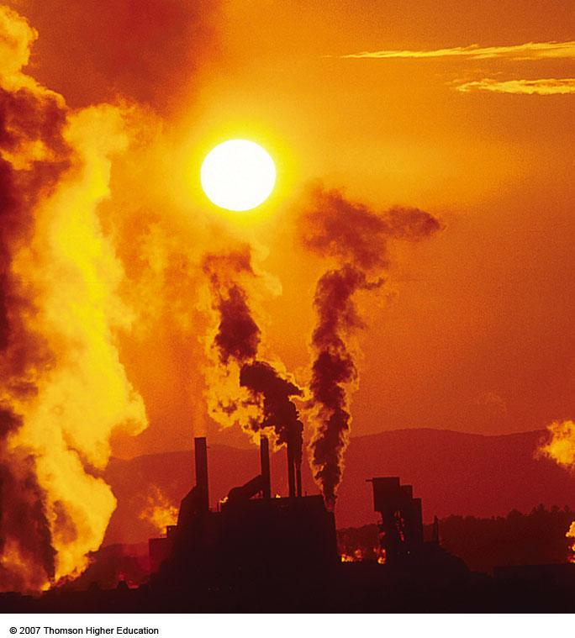
POLLUTION
Figure 1-9

Slide 26
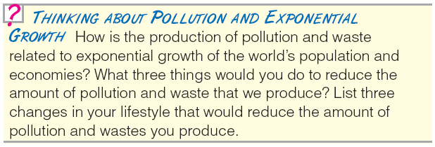
Pollution
Pollutants can have three types of unwanted effects:
Can disrupt / degrade life-support systems.
Can damage health and property.
Can create nuisances such as noise and unpleasant smells, tastes, and sights.

Slide 27
ENVIRONMENTAL PROBLEMS: CAUSES AND CONNECTIONS
The major causes of environmental problems are:
Population growth
Wasteful resource use
Poverty
Poor environmental accounting
Ecological ignorance

Slide 28
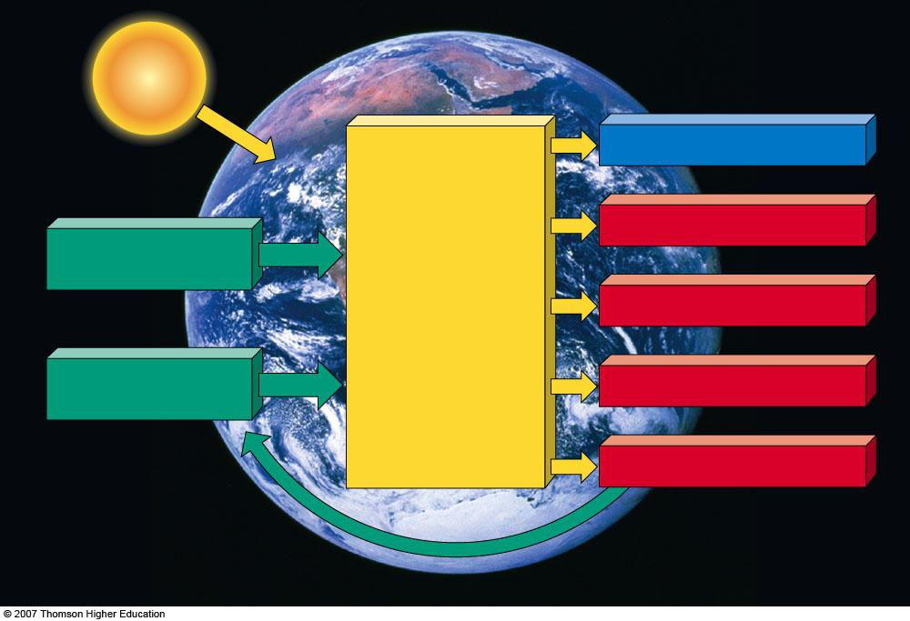
Fig. 1-10, p. 17
SOLAR
CAPITAL
EARTH
Goods and services
Heat
Human Capital
Human
Economic
and
Cultural
Systems
Depletion of nonrenewable resources
Natural Capital
Degradation of renewable resources
Pollution and waste
Fig. 1-10, p. 17
Notes:
Figure 1.10
Natural capital use, depletion, and degradation: human and natural capital produce an amazing array of goods and services for most of the world’s people. But the exponentially increasing flow of material resources through the world’s economic systems depletes nonrenewable resources, degrades renewable resources, and adds heat, pollution, and wastes to the environment.

Slide 29
Natural capital degradation
Figure 1-11

Slide 30
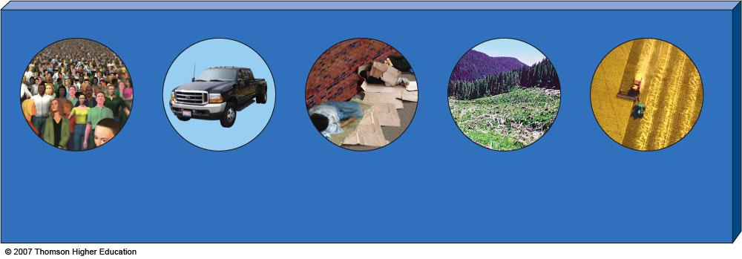
Fig. 1-11, p. 17
Causes of Environmental Problems
Population
growth
Unsustainable
resource use
Poverty
Not including the
environmental costs
of economic goods
and services in their
market prices
Trying to manage and simplify nature with too little knowledge about
how it works
Fig. 1-11, p. 17
Notes:
Figure 1.11
Natural capital degradation: five basic causes of the environmental problems we face. QUESTION: Can you think of any other basic causes?

Slide 31
Solutions: Prevention vs. Cleanup
Problems with relying on cleanup:
Temporary bandage without improvements in control technology.
Often removes a pollutant from one part of the environment to cause problems in another.
Pollutants at harmful levels can cost too much to reduce them to acceptable levels.

Slide 32
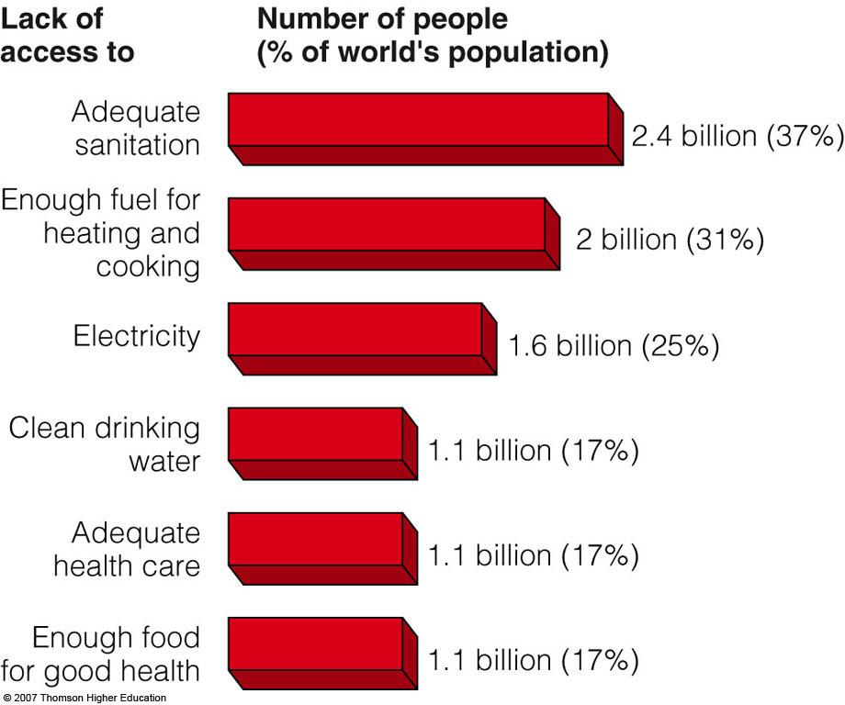
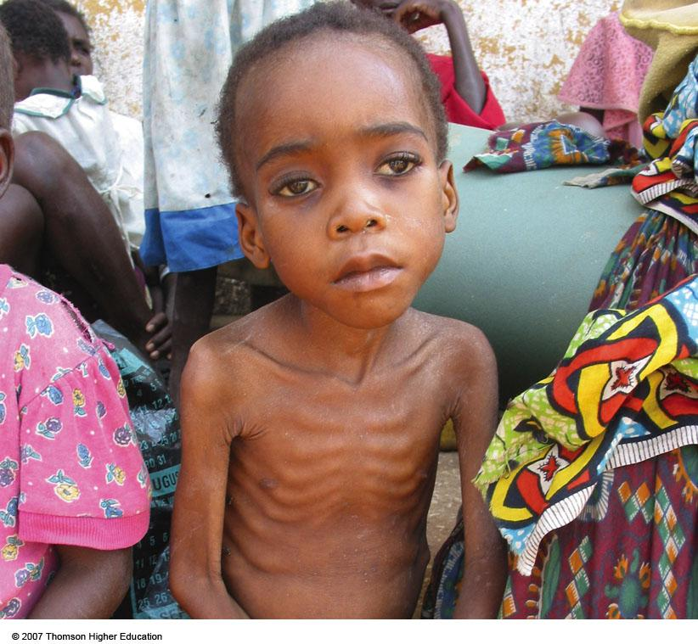
Poverty and Environmental Problems
Figure 1-12 and 1-13

Slide 33
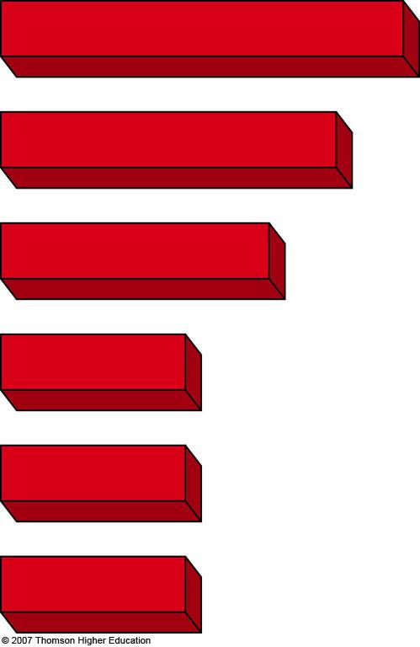
Fig. 1-12, p. 18
Lack of access to
Number of people (% of world's population)
Adequate
Sanitation
2.4 billion (37%)
Enough fuel for
heating and
cooking
2 billion (31%)
Electricity
1.6 billion (25%)
Clean drinking
Water
1.1 billion (17%)
Adequate
health care
1.1 billion (17%)
Enough food
for good health
1.1 billion (17%)
Fig. 1-12, p. 18
Notes:
Figure 1.12
Natural capital degradation: some harmful results of poverty. QUESTION: Which two of these effects do you believe are the most harmful? (Data from United Nations, World Bank, and World Health Organization)

Slide 34
Resource Consumption and Environmental Problems
Underconsumption
Overconsumption
Affluenza: unsustainable addiction to overconsumption and materialism.

Slide 35
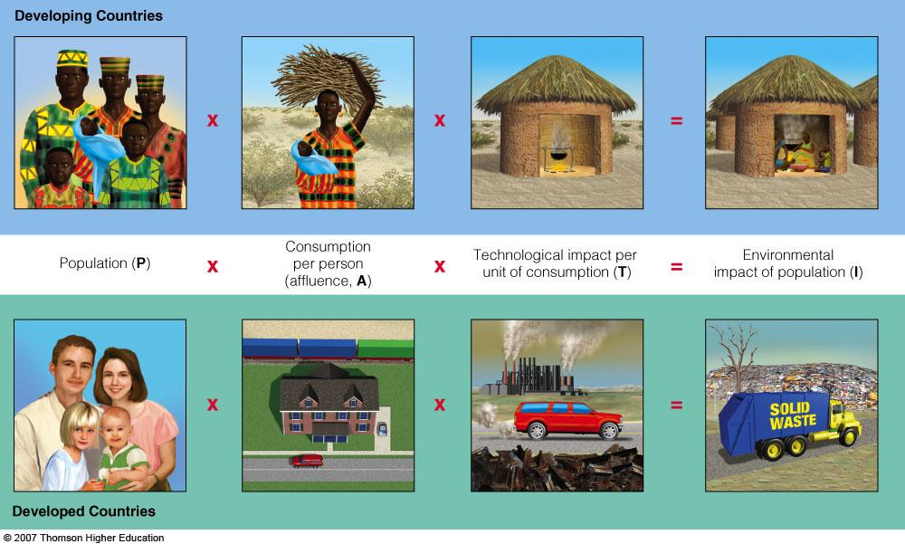
Connections between Environmental Problems and Their Causes
Figure 1-14

Slide 36
Fig. 1-14, p. 20
Developing Countries
Consumption
per person
(affluence, A)
Technological impact per unit of consumption (T)
Environmental
impact of population (I)
Population (P)
Developed Countries
Fig. 1-14, p. 20
Notes:
Figure 1.14
Connections: simplified model of how three factors—number of people, affluence, and technology—affect the environmental impact of the population in developing countries (top) and developed countries (bottom).

Slide 37
CULTURAL CHANGES AND THE ENVIRONMENT
Agricultural revolution
Allowed people to stay in one place.
Industrial-medical revolution
Led shift from rural villages to urban society.
Science improved sanitation and disease control.
Information-globalization revolution
Rapid access to information.

Slide 38
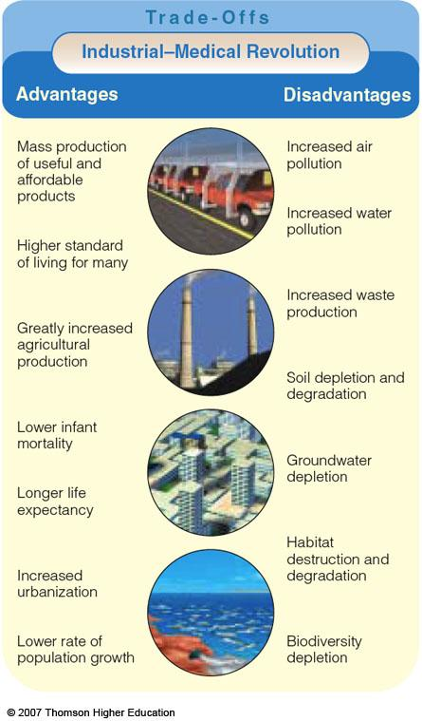
Figure 1-15

Slide 39
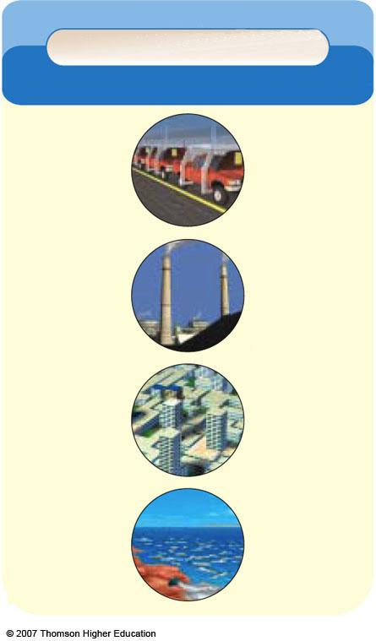
Trade-Offs
Industrial-Medical Revolution
Advantages
DIsadvantages
Mass production of useful and affordable products
Increased air pollution
Increased water pollution
Higher standard of living for many
Increased waste pollution
Greatly increased agricultural production
Soil depletion and degradation
Lower infant mortality
Groundwater depletion
Longer life expectancy
Habitat destruction and degradation
Increased urbanization
Lower rate of population growth
Biodiversity depletion
Fig. 1-15, p. 23

Slide 40
SUSTAINABILITY AND ENVIRONMENTAL WORLDVIEWS
Technological optimists:
suggest that human ingenuity will keep the environment sustainable.
Environmental pessimists:
overstate the problems where our environmental situation seems hopeless.

Slide 41
How Would You Vote?
To conduct an instant in-class survey using a classroom response system, access “JoinIn Clicker Content” from the PowerLecture main menu for Living in the Environment.
Is the society you live in on an unsustainable path?
a. Yes: Without readily available green products and services, converting to a sustainable society is unrealistic.
b. Not entirely: I'm doing what I can to improve sustainability, including recycling and using less energy.

Slide 42
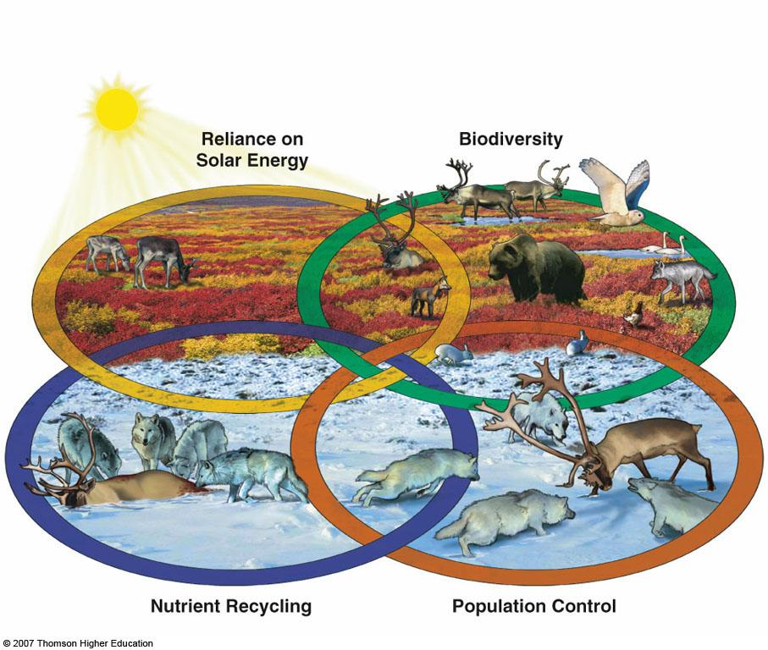
Four Scientific Principles of Sustainability: Copy Nature
Figure 1-16

Slide 43
Fig. 1-16, p. 24
Reliance on
Solar Energy
Biodiversity
Nutrient Recycling
Population Control
Fig. 1-16, p. 24
Notes:
Figure 1.16
Four scientific principles of sustainability: these four interconnected principles of sustainability are derived from learning how nature has sustained a variety of life on the earth for about 3.7 billion years. The top left oval shows sunlight stimulating the production of vegetation in the Arctic tundra during its brief summer (solar energy) and the top right oval shows some of the diversity of species found there during the summer (biodiversity). The bottom right oval shows Arctic gray wolves stalking a caribou during the long cold winter (population control). The bottom left oval shows Arctic gray wolves feeding on their kill. This plus huge numbers of tiny decomposers that convert dead matter to soil nutrients recycle the nutrients needed to support the plant growth shown in the top left and right ovals (nutrient recycling).

Slide 44
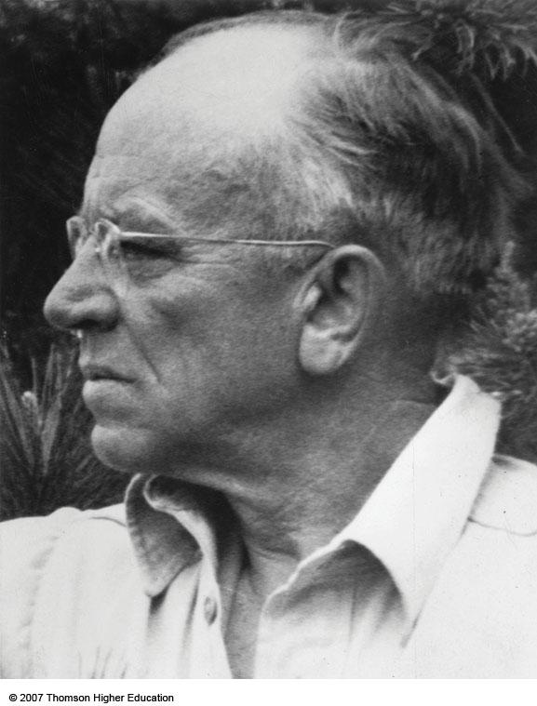
Aldo Leopold’s Environmental Ethics
Individuals matter.
… land is to be loved and respected is an extension of ethics.
We abuse land because we regard it as a commodity…
Figure 1-A

Slide 45
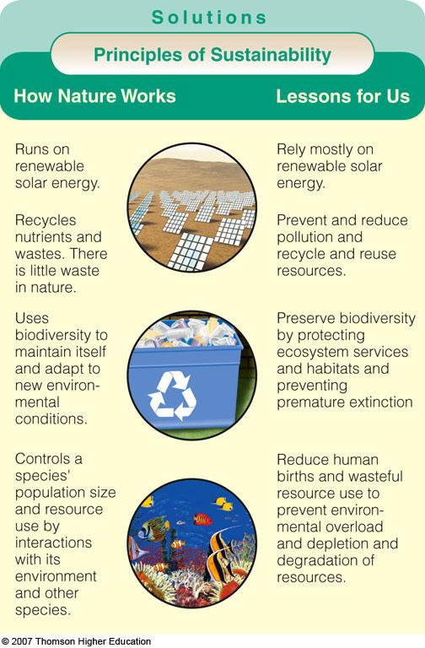
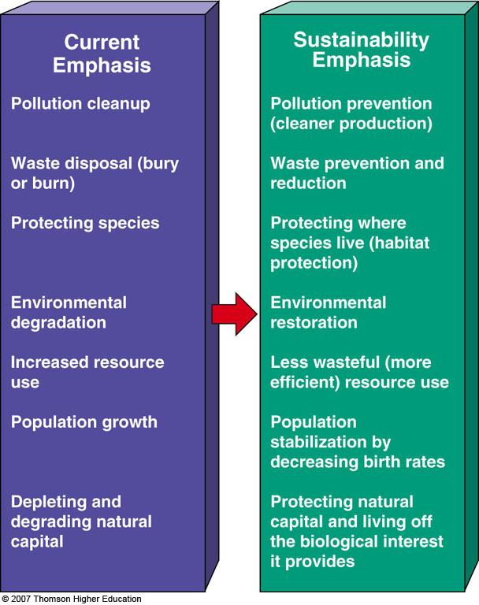
Implications of the Four Scientific Principles of Sustainability
Figures 1-17 and 1-18

Slide 46
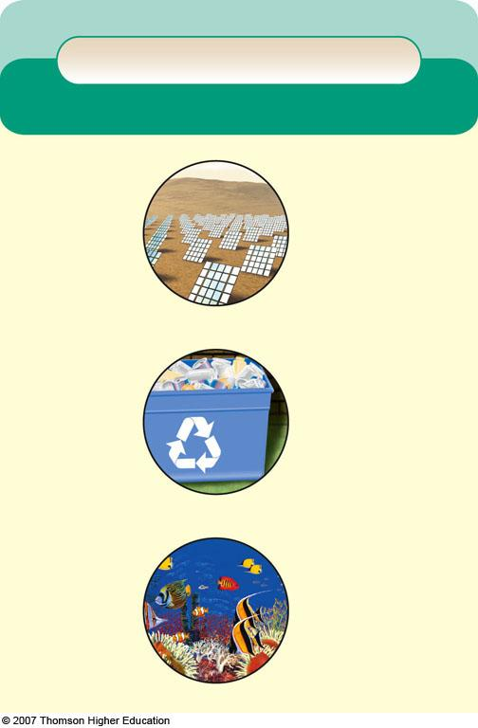
Fig. 1-17, p. 25
Solutions
Principles of Sustainability
How Nature Works
Lessons for Us
Runs on renewable
solar energy.
Rely mostly on renewable solar energy.
Recycles nutrients
and wastes. There
is little waste in
nature.
Prevent and reduce
pollution and recycle
and reuse resources.
Uses biodiversity to
maintain itself and adapt to new environ-
mental conditions.
Preserve biodiversity
by protecting ecosystem services and habitats
and preventing premature extinction of species.
Controls a species’
population size and
resource use by interactions with its
environment and other species.
Reduce human births and wasteful resource
use to prevent
environmental overload and depletion and degradation of resources.
Fig. 1-17, p. 25
Notes:
Figure 1.17
Solutions: implications of the four scientific principles of sustainability derived from observing nature (left) for the long-term sustainability of human societies (right).

Slide 47
Fig. 1-18, p. 25
Notes:
Figure 1.18
Solutions: some shifts involved in bringing about the environmental or sustainability revolution.

Slide 48
Current
Emphasis
Pollution cleanup
Waste disposal (bury or burn)
Protecting species
Environmental degradation
Increased resource use
Population growth
Depleting and degrading natural capital
Sustainability
Emphasis
Pollution prevention (cleaner production)
Waste prevention and reduction
Protecting where species live (habitat protection)
Environmental restoration
Less wasteful (more efficient) resource use
Population stabilization by decreasing birth rates
Protecting natural capital and living off the biological interest it provides
Stepped Art
Fig. 1-18, p. 25

