Slide 1
Milestone Minutes Ecology Week 4

Slide 2
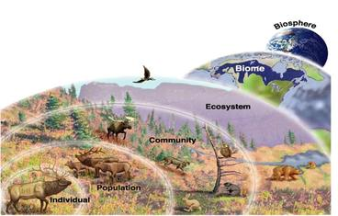
Organisms are dependent on one another within an ecosystem.
Species – one specific type of organism, individual
Population – a group of the same species of organisms
Community – groups of populations of species of organisms
Ecosystem –groups of communities of organisms and abiotic factors (soil, water, air, etc.)

Slide 3
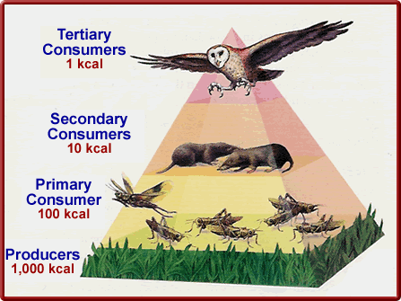
Energy and matter flows from one organism to another within an ecosystem.
Producer- organisms that make their own food, autotrophs (plants)
Herbivores – organisms that feed on producers
Carnivores –organisms that feed on herbivores
Omnivores – organisms that feed on carnivores, herbivores or producers.

Slide 4
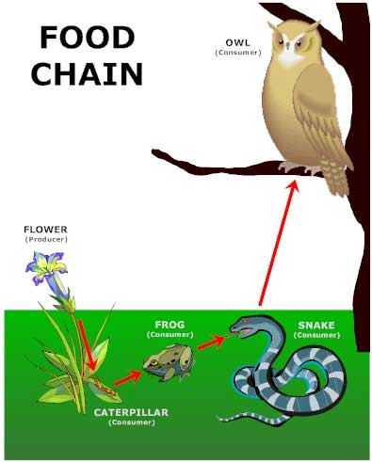
Energy/biomass are reduced as they are transferred from one trophic level to the next on an energy pyramid Food chains show a linear transfer of energy and always begin with a producer.

Slide 5
Food webs show a group of related food chains.

Slide 6
The biosphere is dominated by specific biomes found in different regions of the globe. Tundra Taiga Temperate Forest Rainforest Desert Grassland

Slide 7
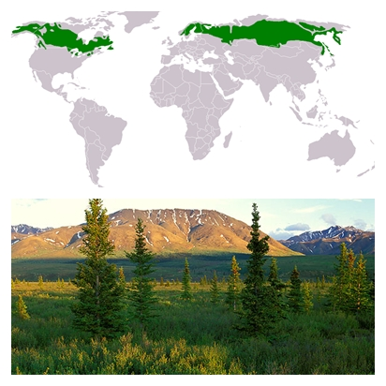
Regions of the Biosphere
Tundra
Taiga
Very cold, permafrost, lichens/mosses, animals with high fat content, North pole
Cold, evergreen forest (conifers), animals with heavy coats, Northern Latitudes.

Slide 8
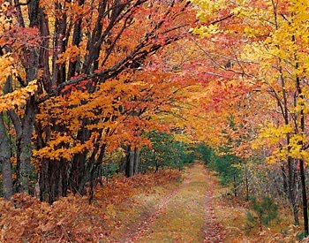
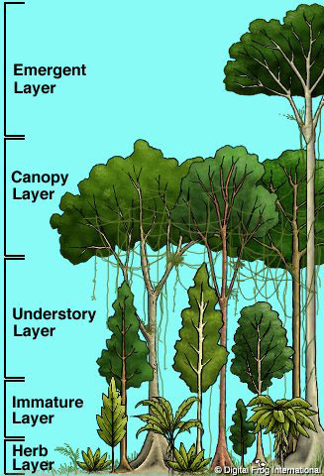
Regions of the Biosphere
Temperate Forest
Rainforest
Seasonal, deciduous forest, Northeast United States
Humid, dense tropical vegetation, diverse animal life, sub equator.

Slide 9
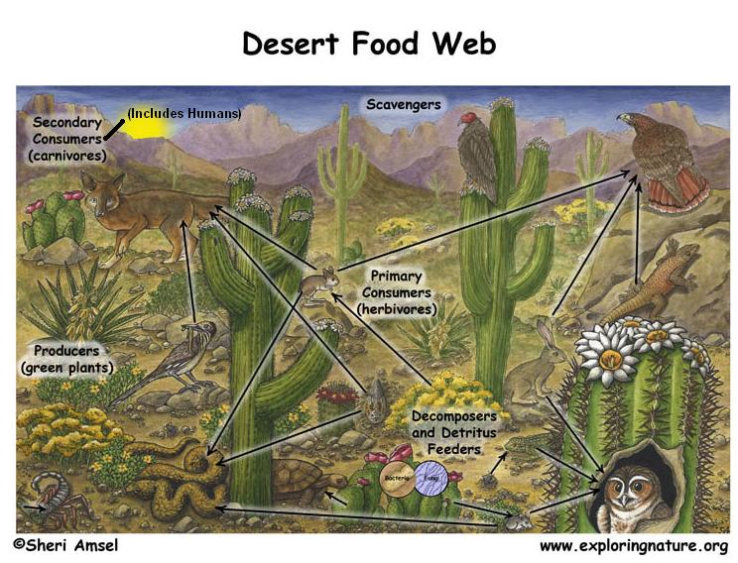
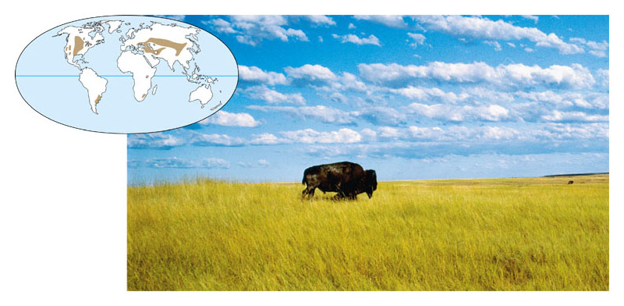
Regions of the Biosphere
Desert
Grassland
Dry, fleshy/water conserving plants, cold blooded animals, SW United States
Arid, grasses/shrubs, burrowing/grazing animals, Midwest United States.

Slide 10
Human behavior can have a negative impact on the environment.
Global Warming can result from the burning of non-renewable fossil fuels (coal, oil, gasoline)
Using renewable energy sources (water, wind) and electric cars can reduce global warming.

Slide 11
Human impact on the environment.
Coliform bacteria can indicate the presence of contaminated water.
Overuse of pesticides and herbicides can cause resistant organisms.

Slide 12
Succession is the gradual change in the community of an ecosystem. Primary succession starts with lichen (pioneer species) and is usually followed by the growth of mosses, grasses, shrubs and trees (climax species). Secondary succession results from a natural disaster and follows the same pathway of primary succession.

Slide 13
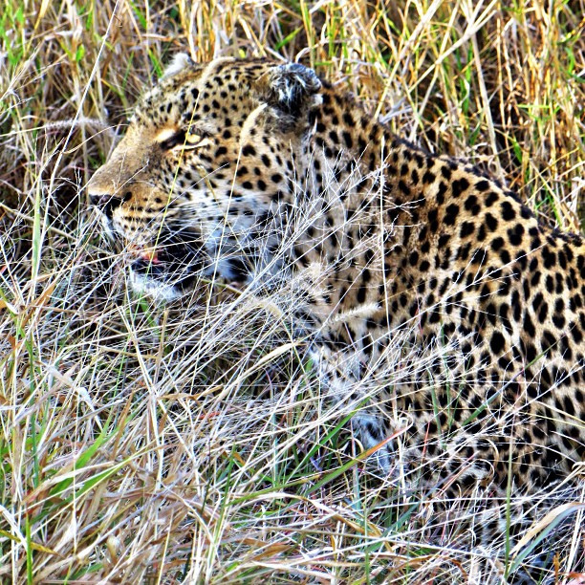
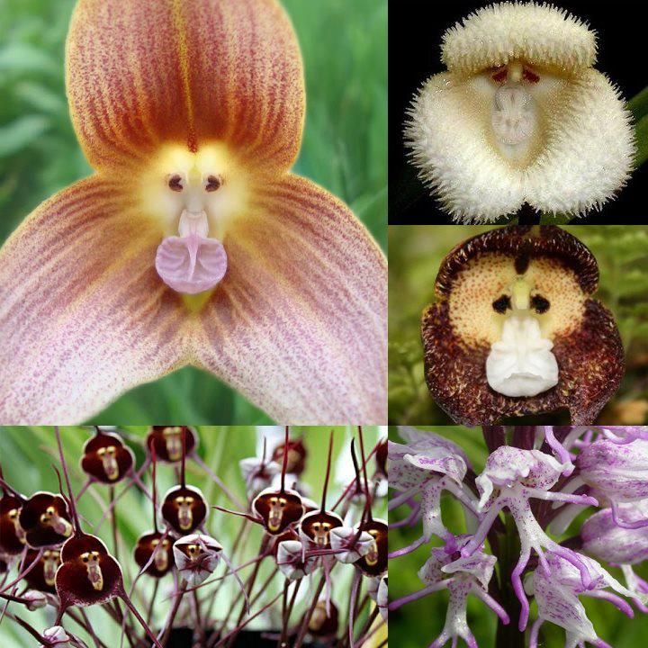
Plant and animal behaviors can increase chances of survival.
Camouflage
Mimicry
Blending in with the surrounding environment
Resembling the protective advantages of another organism

Slide 14
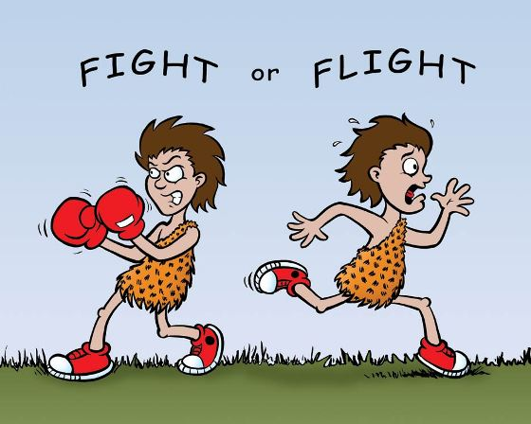
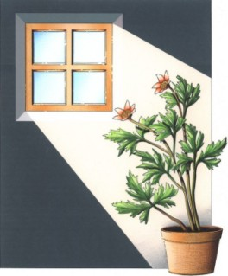
Plant and Animal behaviors can increase chances of survival.
Flight/Flee
Tropism
Using speed and escape tactics to avoid predators
Growth of a plant to an environmental stimulus (Phot0tropism- Light, Gravitropism-Gravity)

